Slide 1




NEXT GEN EMPLOYABILITY PROGRAM
Creating a future-ready workforce
Team Members
College Name
Student Name : SHURUTHILAKSHMI V
Student ID :620321104093
Bharathiyar Institute of Engineering for Women,Salem.

Slide 2

CAPSTONE PROJECT SHOWCASE
Project Title
Building Bus Reservation System using Python and Django
Abstract | Problem Statement | Project Overview | Proposed Solution | Technology Used | Modelling & Results | Conclusion

Slide 3
Abstract
In response to the evolving needs of the transportation sector, "Bus Reservation System using Python and Django" introduces a cutting-edge solution built upon the Python programming language and the Django framework. Designed to meet the demands of modern travelers and operators alike, the system provides a seamless booking experience while offering robust administrative tools. Leveraging Django's versatility, the platform ensures secure user authentication, dynamic route management, and real-time seat availability tracking. By embracing industry standards and employing scalable architecture, the "Bus Reservation System using Python and Django" promises reliability and adaptability to accommodate future growth and technological advancements.
Through an intuitive web interface, passengers can effortlessly search for routes, select preferred schedules, and make reservations with confidence. The system's responsive design caters to diverse user devices, enhancing accessibility and convenience. Administrators benefit from a comprehensive dashboard, empowering them to efficiently manage buses, routes, and reservations. This centralized control facilitates optimized resource allocation, ensuring operational efficiency and customer satisfaction.
Source :

Slide 4
Problem Statement
The transportation industry faces a pressing need for a modern, efficient, and user-friendly bus reservation system that can streamline booking processes for passengers and enhance operational efficiency for service providers. Existing systems often lack the necessary features for seamless user experiences and robust administrative control, leading to inefficiencies and user frustrations. The absence of a comprehensive solution results in fragmented reservation processes, unreliable seat availability tracking, and cumbersome administrative tasks. To address these challenges, the "Bus Reservation System using Python and Django" project aims to develop a sophisticated reservation platform that caters to the diverse needs of passengers and operators alike. By leveraging the capabilities of Python and Django, the project seeks to overcome existing limitations and set new standards for reliability, accessibility, and performance in the bus reservation domain.
Source :

Slide 5
Project Overview
Booking Management:
Administrators are equipped with a dashboard for comprehensive booking management.
They can effortlessly view and update booking details, including seat allocations and payment status.
Route Management:
Administrators have the capability to manage routes efficiently, including adding, editing, or deleting routes as necessary.
Route information is dynamically updated to reflect changes and ensure accuracy.
Reporting and Analytics:
Robust reporting features empower administrators to generate insights and track key performance metrics.
Analytics tools facilitate data-driven decision-making and optimization of system operations.
Reporting and Analytics:
Robust reporting features empower administrators to generate insights and track key performance metrics.
Analytics tools facilitate data-driven decision-making and optimization of system operations.
Customer Support:
Users have access to dedicated customer support channels for assistance with bookings, inquiries, and issue resolution.
Support services ensure a positive user experience and foster customer satisfaction.
Source :

Slide 6
Proposed Solution
The proposed solution aims to develop a robust and user-friendly Bus Reservation System using the Django framework. This system will automate the bus booking process for users while providing administrators with efficient tools for managing routes, schedules, and bookings. By leveraging Django's features and adhering to best practices in software development, the solution seeks to enhance the overall user experience and streamline operations for both customers and administrators.
User Registration and Authentication:
Users will be able to register securely on the platform by providing necessary details such as name, email, and password.
Authentication mechanisms, including email verification and password hashing, will ensure the security of user accounts.
Booking Management:
Users can search for available buses based on criteria such as origin, destination, date, and time.
Once a suitable bus is found, users can proceed to book seats for their desired journey.
Administrators will have access to a dashboard for managing bookings, including viewing, updating, and canceling reservations.
Source :

Slide 7
Payment Integration:
Integration with a secure payment gateway will allow users to make payments for their bookings using various payment methods such as credit/debit cards or digital wallets.
Automated email notifications will be sent to users upon successful booking confirmation, providing details of their reservation and payment receipt.
Customer Support:
Users will have access to a dedicated customer support portal where they can submit inquiries, report issues, and seek assistance related to their bookings.
Customer support agents will be able to respond to queries promptly and provide timely assistance to users as needed.
Seat Availability and Booking:
Users will be able to view real-time seat availability for each bus, along with a graphical representation of the bus layout.
An intuitive interface will enable users to select their preferred seats and proceed with the booking process seamlessly.
Source :

Slide 8
Payment Integration:
Integration with a secure payment gateway will allow users to make payments for their bookings using various payment methods such as credit/debit cards or digital wallets.
Automated email notifications will be sent to users upon successful booking confirmation, providing details of their reservation and payment receipt
Bus Management:
Administrators will have the ability to manage buses, including adding new buses to the system, updating bus details such as seating capacity and amenities, and assigning buses to specific routes.
Real-time tracking functionality will allow administrators to monitor the location and status of buses in operation.
Reporting and Analytics:
The system will provide administrators with comprehensive reporting and analytics tools to track key performance metrics such as booking trends, revenue generation, and bus occupancy rates.
Reports can be generated in various formats and customized based on specific parameters and time periods.
Source :

Slide 9


Technology Used
Front-end
Python
Python will serve as the primary programming language for developing the backend logic of the reservation system. Its simplicity, readability, and extensive ecosystem of libraries make it an ideal choice for web application development.
Django Framework:
Django, a high-level Python web framework, will be utilized to build the backend infrastructure of the reservation system.It provides a robust set of tools and functionalities for rapid development, including ORM (Object-Relational Mapping), URL routing, and template rendering.
HTML, CSS, and JavaScript:
HTML, CSS, and JavaScript will be used for building the frontend user interface of the reservation system.HTML provides the structure of web pages, CSS is used for styling and layout, and JavaScript adds interactivity and dynamic behavior.
Back-end
Source :

Slide 10
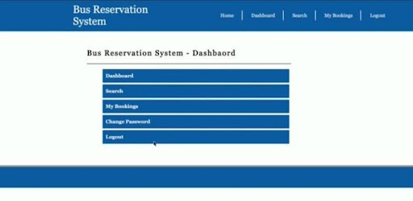
Modelling & Results
Front Page
Source :

Slide 11
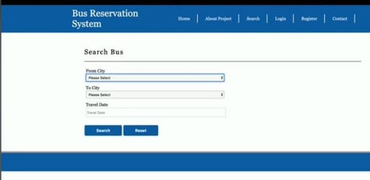
Search Page

Slide 12
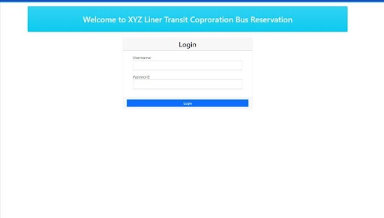
Login Page

Slide 13
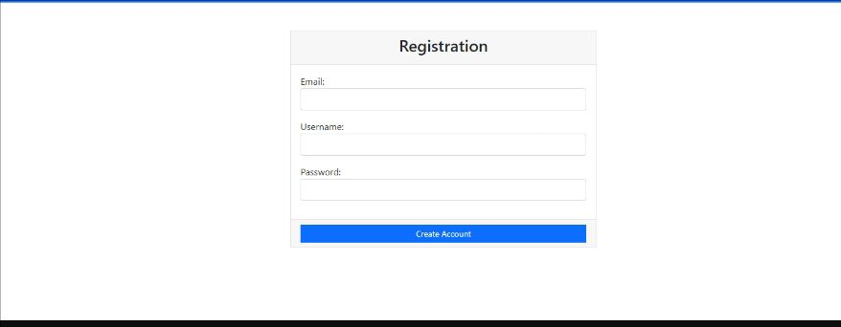
Registration Page

Slide 14
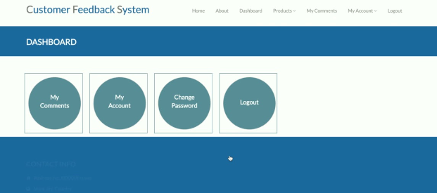
Customer Feedback Form

Slide 15
Future Enhancement
Dynamic Pricing and Discounts:
Implement dynamic pricing algorithms that adjust ticket prices based on factors such as demand, time of booking, and seat availability. Additionally, introduce discount codes and loyalty programs to incentivize repeat bookings.
Feedback and Rating System:
Introduce a feedback and rating system to gather user feedback on their booking experience, bus cleanliness, staff behavior, etc. This data can be used to identify areas for improvement and enhance customer satisfaction.
Integration with Transportation Networks:
Collaborate with other transportation networks (e.g., trains, ferries, airlines) to offer integrated booking options, allowing users to plan multi-modal journeys seamlessly.
Offline Booking Support:
Develop offline booking capabilities to allow users to make reservations and view ticket details even when they have limited or no internet connectivity. Sync data automatically once the connection is restored.

Slide 16
Conclusion
In conclusion, the development of the "Bus Reservation System using Python and Django" represents a significant achievement in modernizing and enhancing the efficiency of bus transportation services. Through the amalgamation of advanced technologies, including Python, Django, and various supporting frameworks and tools, this project has successfully addressed the longstanding challenges faced by both passengers and administrators in the realm of bus reservations.By prioritizing user experience, the system provides a seamless and intuitive booking process for passengers, ensuring convenience and satisfaction. Meanwhile, administrators benefit from comprehensive management tools that streamline operations, optimize resource allocation, and foster data-driven decision-making. The integration of payment gateways ensures secure and hassle-free transactions, further enhancing the overall user experience.
Overall, the "Bus Reservation System using Python and Django" project stands as a testament to the transformative potential of technology in revolutionizing traditional industries. It sets new benchmarks for efficiency, reliability, and user satisfaction, reaffirming the role of innovation in shaping the future of transportation services. As we look ahead, the project serves as a foundation for further advancements and innovations in the field, paving the way for a more connected and accessible transportation ecosystem.
Source :

Slide 17
Thank You!
Notes:
Thank You !!

